Slide 1


AI in Product Management

Slide 2
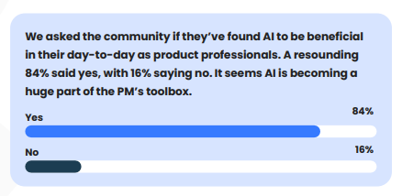

Slide 3
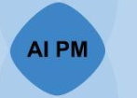
AI Product Management
AI product managers are the ultimate collaborators with cross-functional teams of data scientists, engineers, designers, and marketers.
They craft AI products that meet customer expectations and align with the organization’s broader objectives.

Slide 4
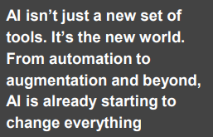
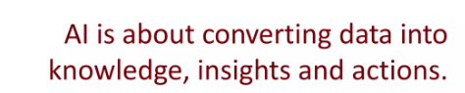
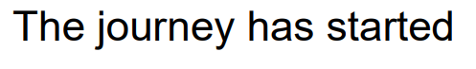

Slide 5
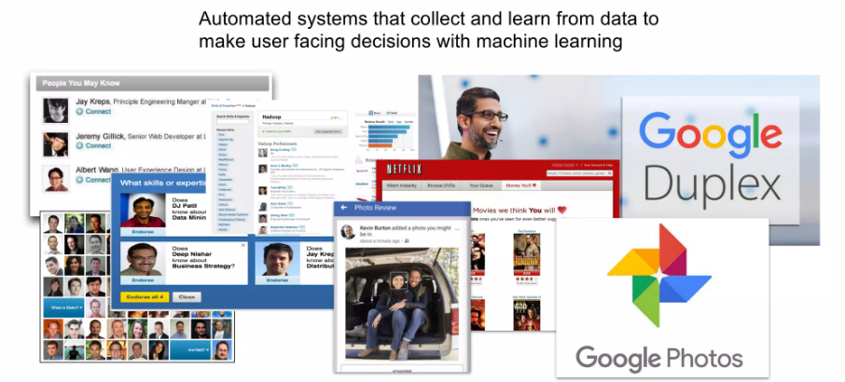

Slide 6
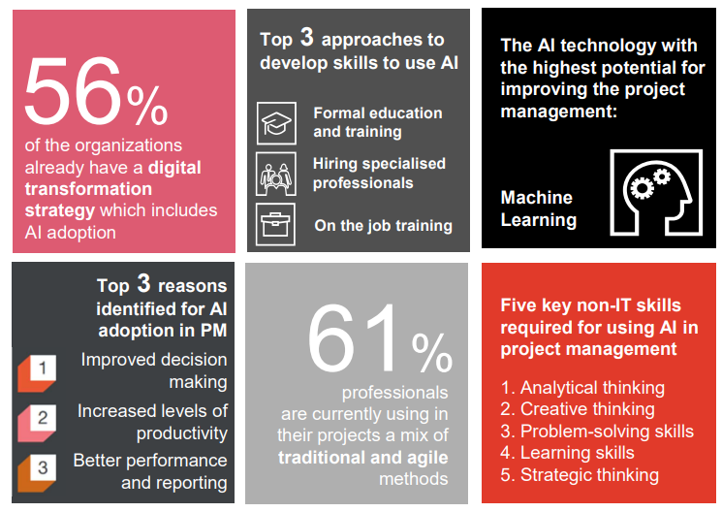


Slide 7
Levels of AI
Level 1:Manual Process
Level 2: Human intervention with AI assistance
Level 3:AI Driven with Fine tuning
Level 4:Fully Automated by AI

Slide 8
Understanding AI In PM

Slide 9
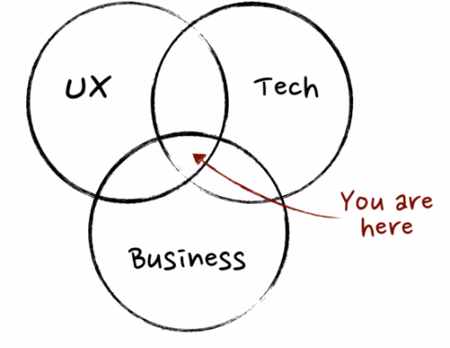

Slide 10
How to use AI in Product World

Slide 11
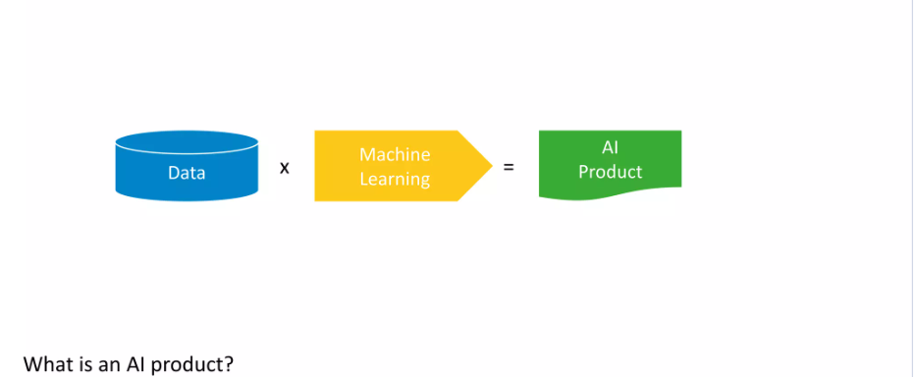

Slide 12
Making AI work

Slide 13
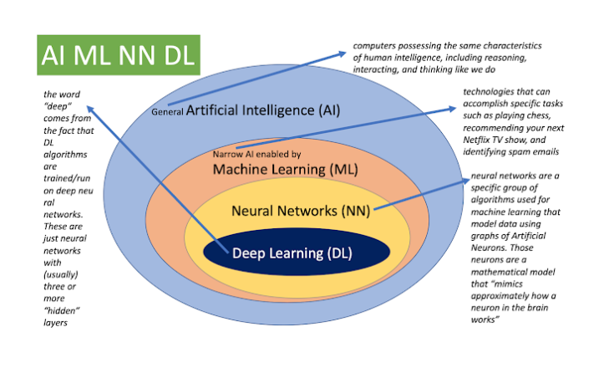

Slide 14
Data?

Slide 15
Types of Analytics

Slide 16
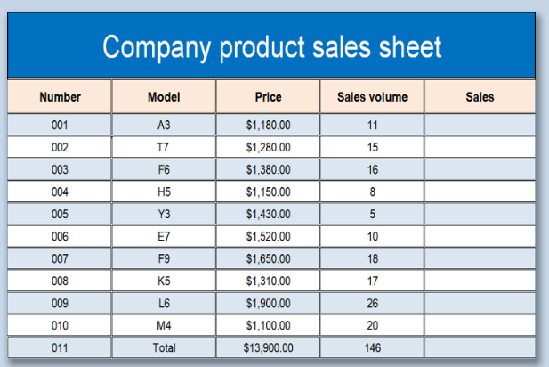
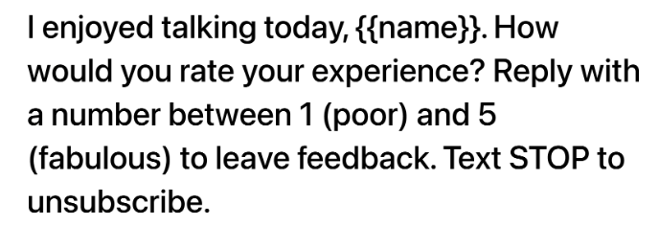

Slide 17
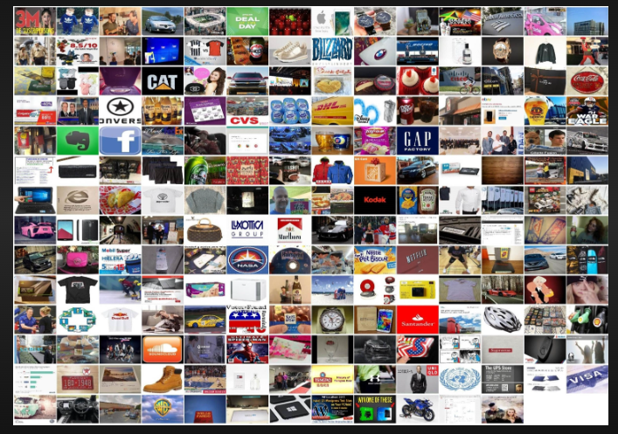
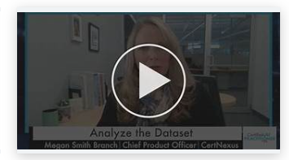
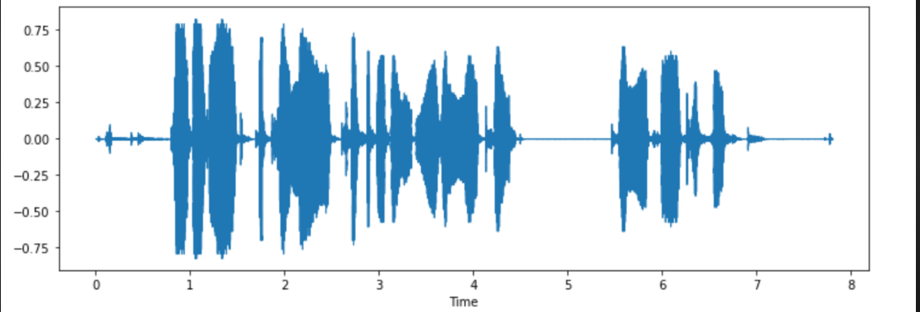

Slide 18






Slide 19
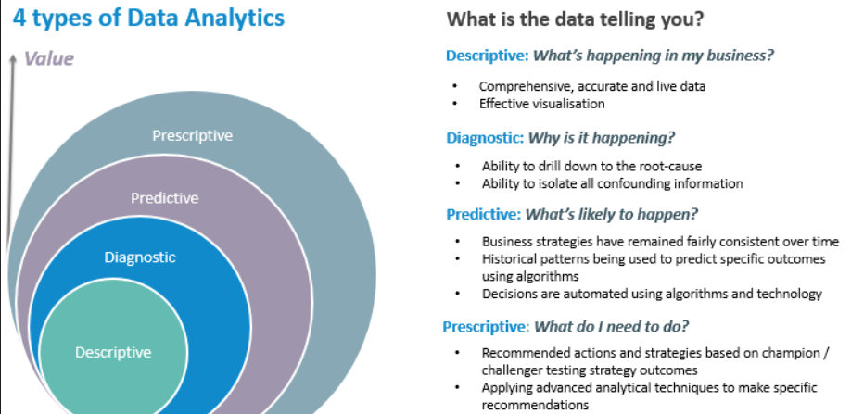

Slide 20
Scenario
TechTrendz is a leading retailer specializing in electronics and gadgets. Over the years, the company has accumulated vast amounts of data related to sales, customer behavior, inventory, and marketing campaigns. Let's follow TechTrendz through their analytics journey.

Slide 21
Analytics?
TechTrendz's analytics team starts by analyzing sales data from the previous year.
They create reports and dashboards to visualize key performance indicators (KPIs) such as total revenue, sales by product category, and geographical sales distribution.
Through descriptive analytics, they gain insights into which products are top sellers, peak sales periods, and popular customer demographics.

Slide 22
Analytics?
After identifying a decline in sales for a particular product line, TechTrendz's analysts dive deeper into the data.
They perform root cause analysis to understand the factors contributing to the decline.
Through diagnostic analytics, they uncover issues such as pricing competitiveness, insufficient marketing efforts, or changes in consumer preferences, enabling them to formulate corrective actions.

Slide 23
Analytics?
Armed with insights from descriptive and diagnostic analytics, TechTrendz's team leverages predictive analytics to forecast sales for the upcoming quarter.
By analyzing historical sales trends, seasonality, economic indicators, and market trends, they develop predictive models to anticipate demand for various products.
These forecasts help the company optimize inventory management, pricing strategies, and resource allocation.

Slide 24
Analytics?
With predictive models in place, TechTrendz's executives turn to prescriptive analytics to determine the best course of action.
Using optimization algorithms, they simulate different scenarios to maximize profitability, minimize costs, or optimize marketing ROI.
For example, they may use prescriptive analytics to decide on promotional strategies, inventory replenishment schedules, or pricing adjustments, ultimately driving business growth and competitiveness.

Slide 25
Why Software Product Managers Need to Understand AI and Machine Learning
How to get AI as a PM

Slide 26
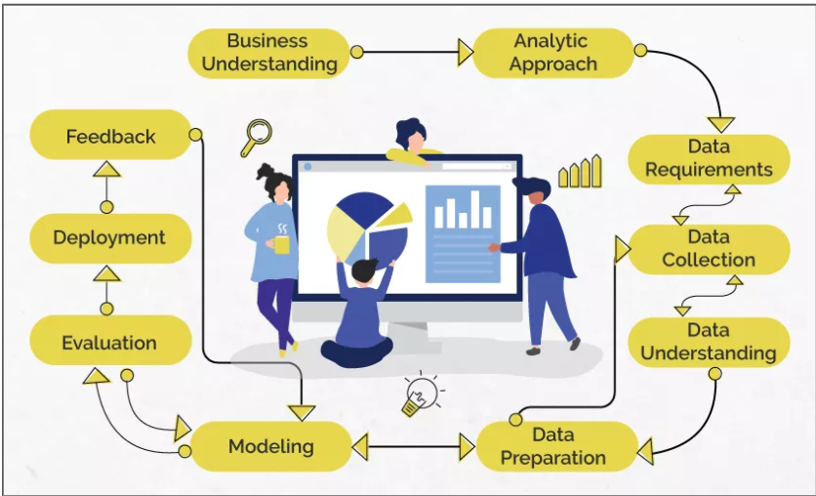
Data Science/Machine Learning

Slide 27
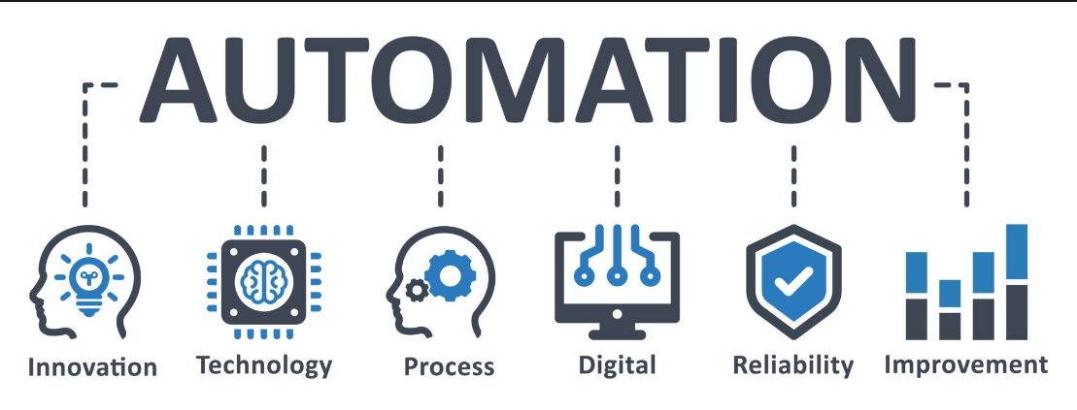
Automating Repetitive Tasks in Product Management

Slide 28
Why?
High volume of repetitive tasks.
Time-consuming manual processes.
Potential for human error.

Slide 29
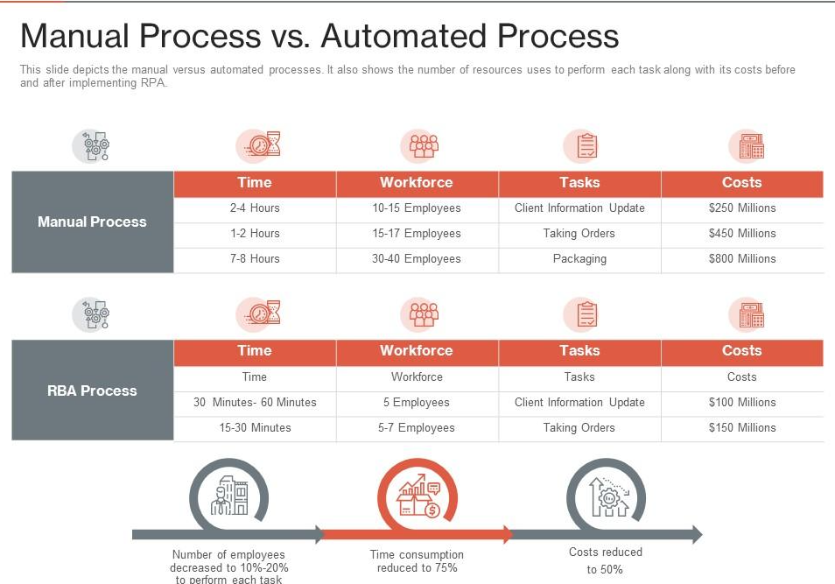

Slide 30
Definition of automation
Automating repetitive tasks using technology.
Streamlining workflows and processes.

Slide 31
Benefits
Efficiency:
Save time on routine tasks.
Increase productivity of team members.
Focus on Strategic Goals:
Allocate resources to innovation and planning.
Improve decision-making with timely insights.

Slide 32
Examples of Automation Impact
Operational Efficiency:
Automating data entry and validation.
Streamlining report generation processes.
Customer Engagement:
Automated responses to common inquiries.
Personalizing customer communications at scale.

Slide 33
Strategic Alignment
Aligning automation with strategic goals:Enhancing product development cycles.
Improving customer satisfaction metrics.

Slide 34
Case Study: Automating Product Feedback Analysis
Problem:
Manual collection and analysis of customer feedback.
Solution:
Implementing sentiment analysis tools.
Integrating with CRM for automated feedback processing.
Results:
Reduced analysis time by X%.
Improved responsiveness to customer concerns.

Slide 35
Implementation Considerations
Assessing current processes:
Identify repetitive tasks suitable for automation.
Selecting tools and technologies:
Workflow automation platforms (e.g., Zapier, Integromat).
Task management tools (e.g., Asana, Trello).
Designing automated workflows:
Mapping out sequences and triggers.
Integrating across existing systems.

Slide 36
Future Trends
AI and Machine Learning:
Predictive analytics for demand forecasting.
Personalization of customer interactions.
IoT Integration:
Real-time data collection and analysis.
Advanced Automation:
Autonomous decision-making in routine tasks.

Slide 37
Conclusion
Recap of benefits:
Increased productivity and efficiency.
Enhanced focus on strategic initiatives.
Call to action:
Encourage adoption of automation tools.
Emphasize its role in driving success in product management.

